Slide 1
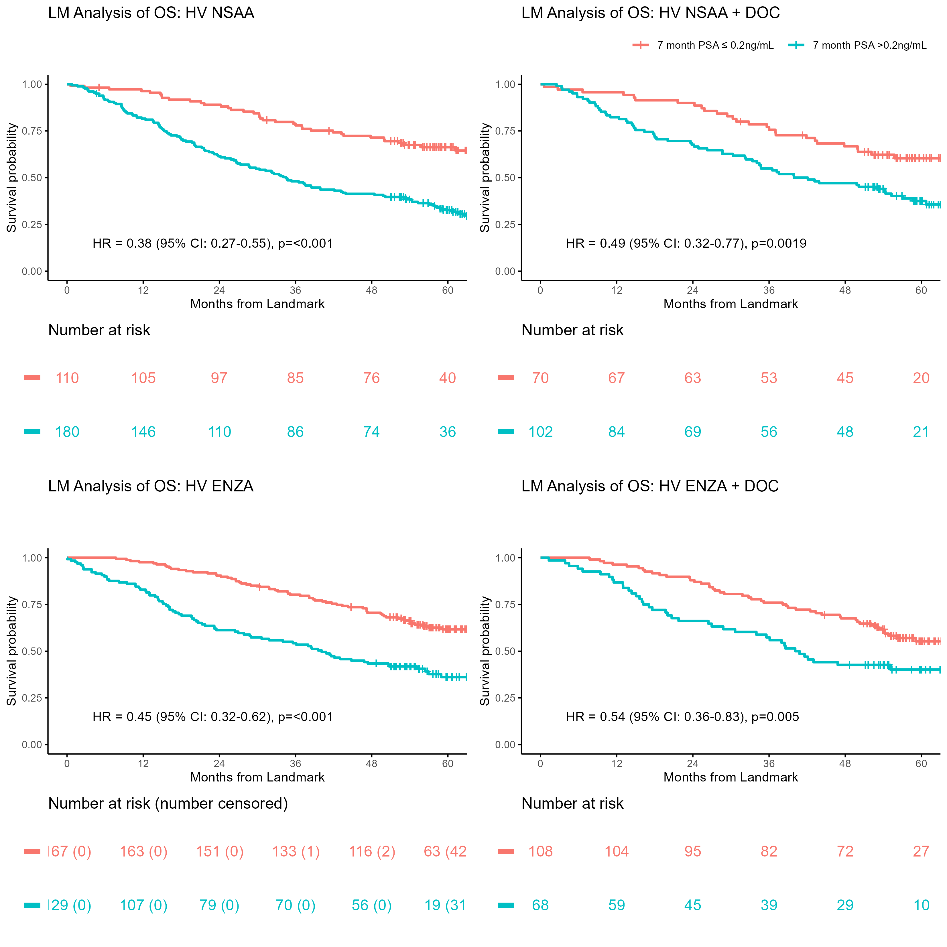
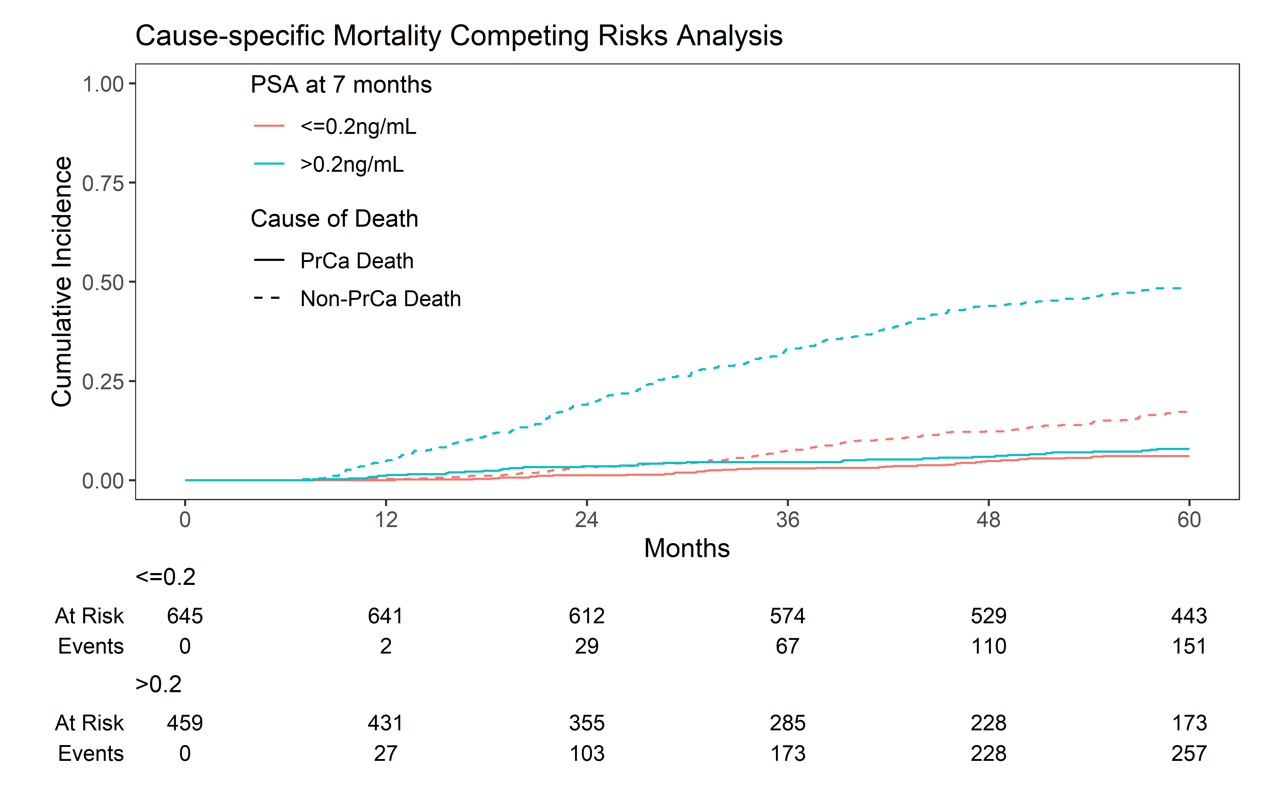
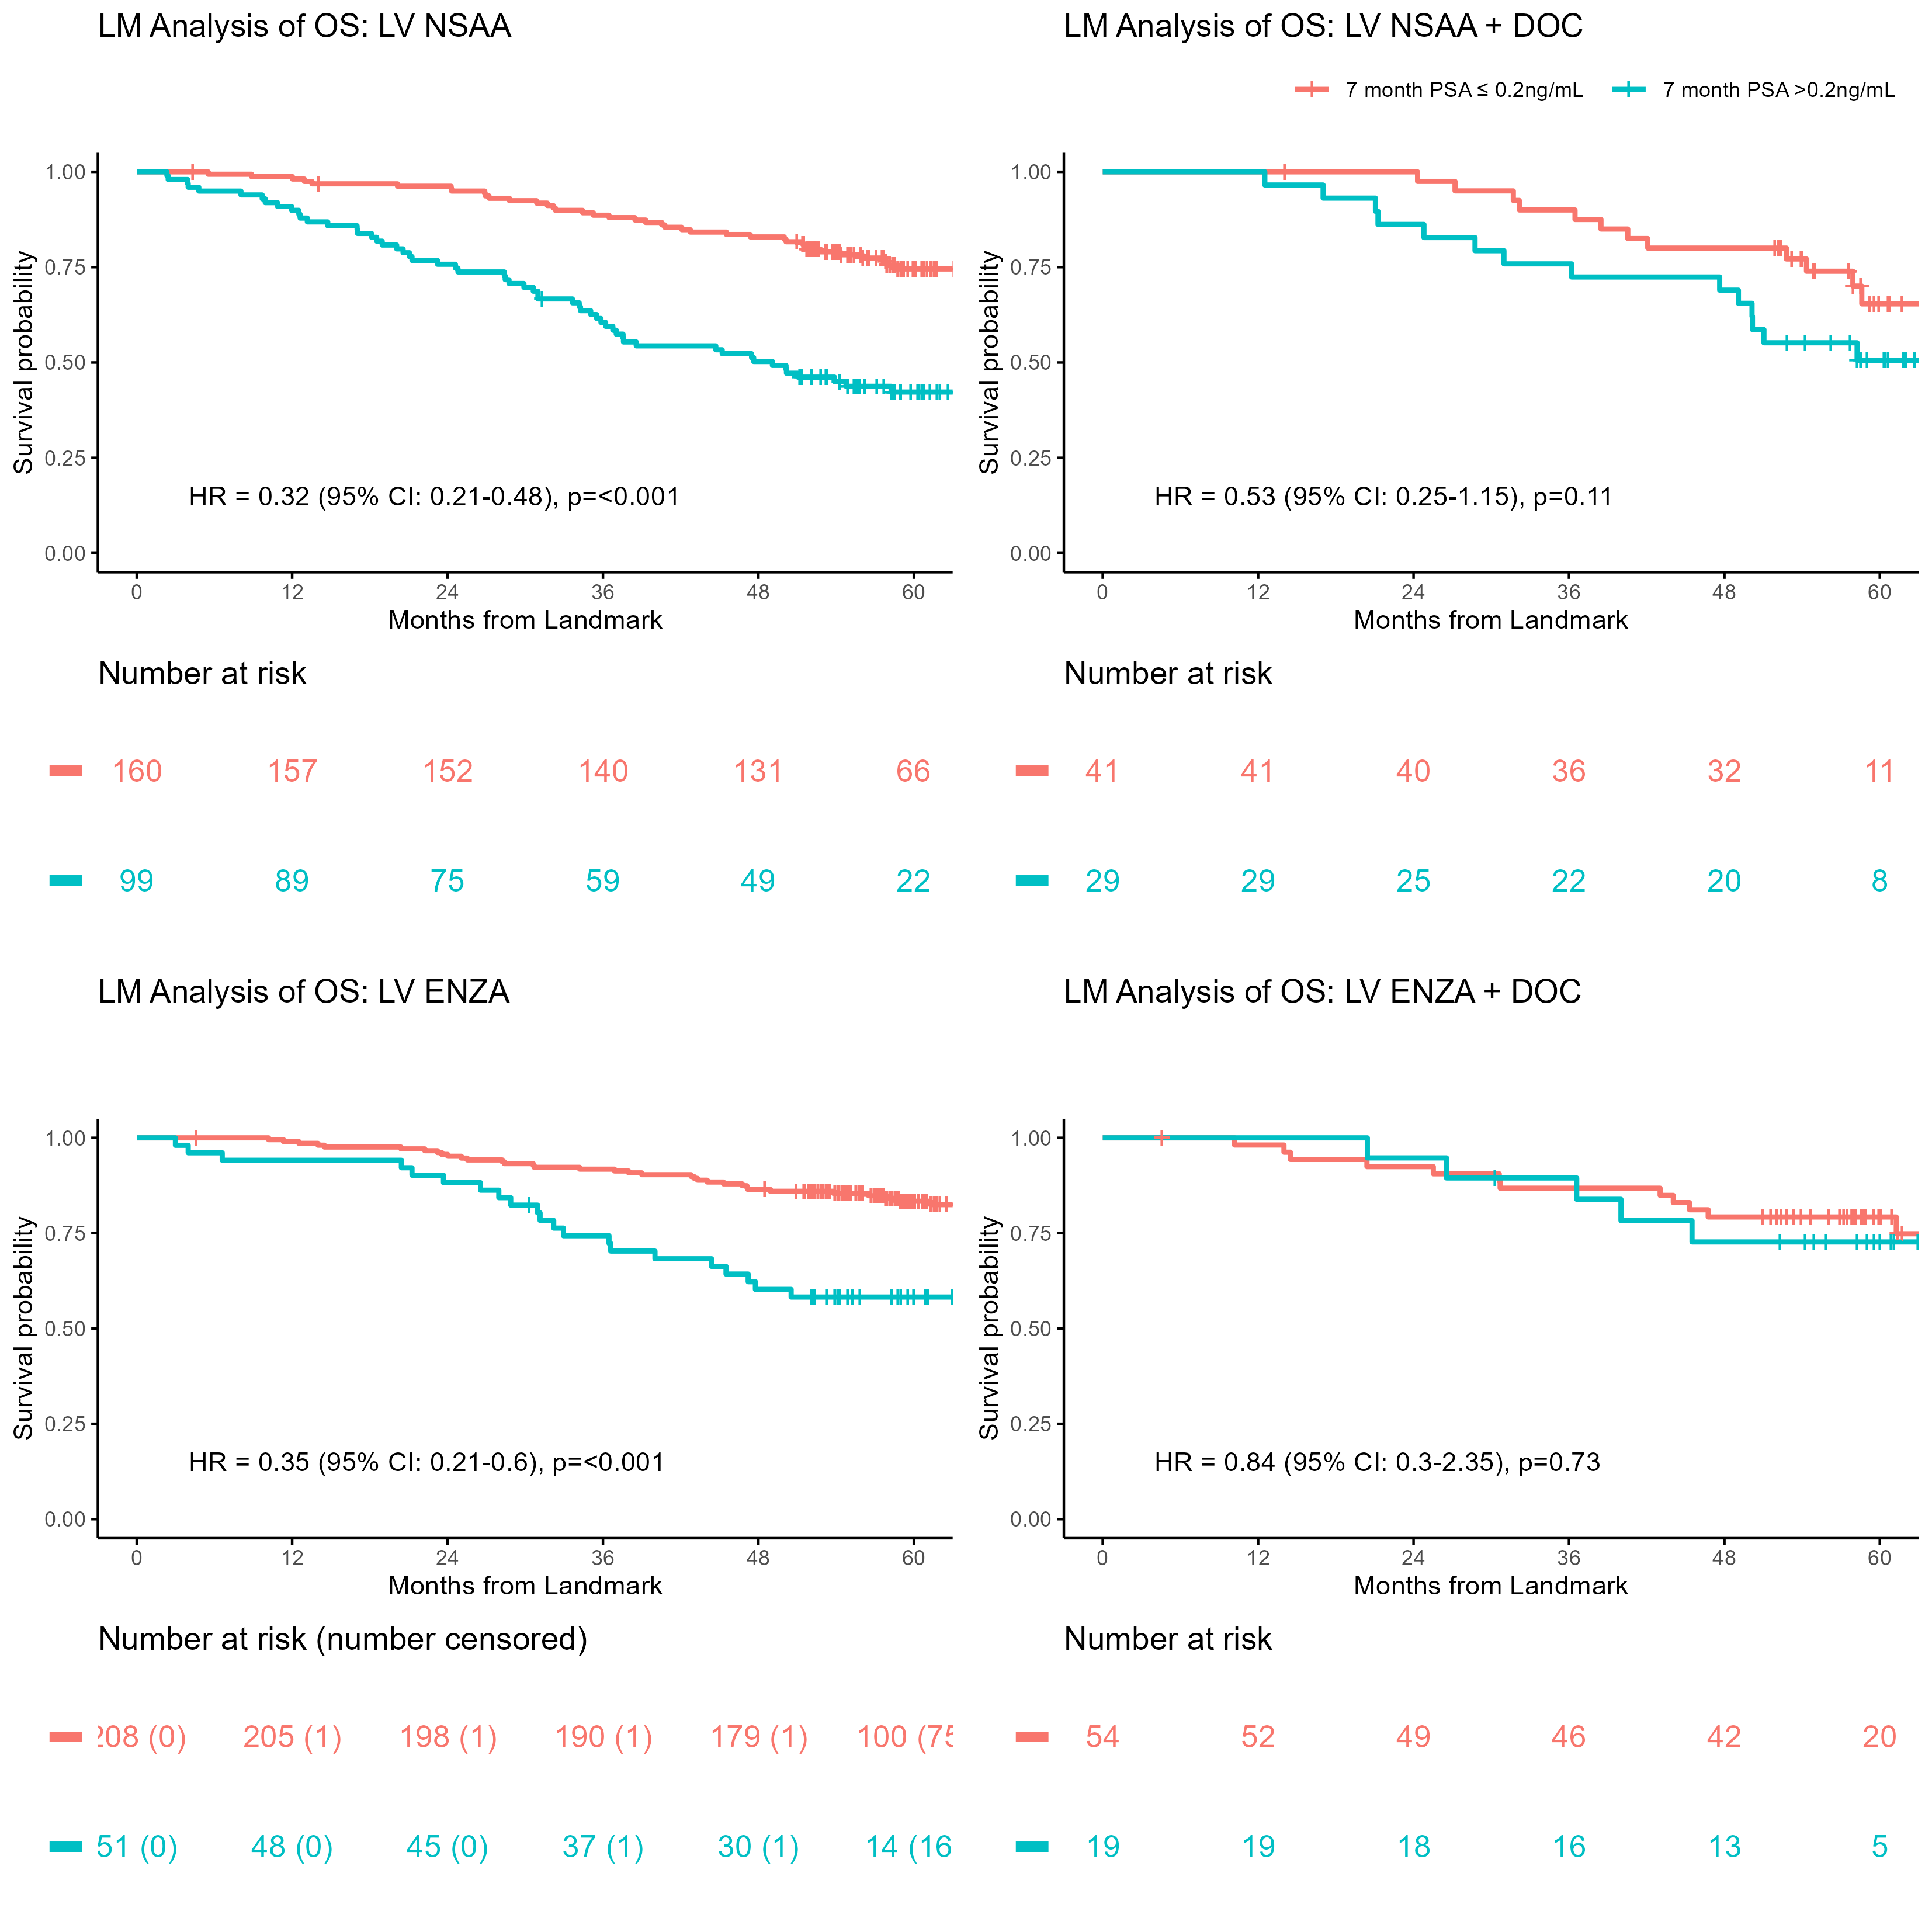
PSA at 7 months is prognostic in metastatic hormone-sensitive prostate cancer (mHSPC) treated with enzalutamide: landmark analysis of ENZAMET (ANZUP 1304)
Ronan A. McLaughlin^{1,18}, Hayley Thomas^{2,18}, Ian D. Davis^{3,18}, Robert R. Zielinski^{4,18}, Alastair Thomson^{5,18}, Thean Hsiang Tan ^{6,18}, Shahneen Sandhu^{7,18}, M. Neil Reaume⁸, David W. Pook^{3,18}, Francis Parnis^{9,18}, Scott A. North^{10,18},
Gavin M. Marx ^{11,18}, John McCaffrey^{1,12,18}, Raymond S. McDermott ^{1,18}, Lisa Horvath^{13,18}, Mark Frydenberg^{14,18}, Simon Chowdhury¹⁵, Kim N. Chi¹⁶, Martin R. Stockler ^{2,18}, Christopher J. Sweeney^{17,18}.
1. Cancer Trials Ireland, Dublin, Ireland; 2. NHMRC Clinical Trials Centre, The University of Sydney, Sydney, Australia 3. Monash University Eastern Health Clinical School, Box Hill, Australia; 4. Orange Hospital & Dubbo Base Hospital & Bathurst Base Hospital, Orange, Dubbo, Bathurst, Australia; 5. Royal Cornwall Hospitals NHS Trust, Truro, United Kingdom; 6. Royal Adelaide Hospital, Adelaide, Australia; 7. Peter MacCallum Cancer Centre, Melbourne, Australia; 8. Ottawa Hospital Cancer Centre, Ottawa, ON; 9. Ashford Cancer Centre Research, Kurralta Park, Australia;. 10. Division of Medical Oncology, Cross Cancer Institute, University of Alberta, Edmonton, AB; 11. Sydney Adventist Hospital, Sydney, Australia; 12. Mater Misercordiae University Hospital, Dublin, Ireland; 13. Chris O'Brien Lifehouse, Camperdown, Australia; 14. Monash University, Dept. of Surgery, Melbourne, Australia; 15. Guy’s, King's, and St. Thomas' Hospitals, London, United Kingdom; 16. BC Cancer Agency, University of British Columbia, Vancouver, BC; 17. South Australian Immunogenomics Cancer Institute, University of Adelaide, Adelaide, Australia; 18. The Australian and New Zealand Urogenital and Prostate Cancer Trials Group;
1. Background
5. Landmark Analysis PSA at 7 months and OS
6. Effect of ENZA on PSA and OS
ENZAMET randomized 1125 participants with mHSPC to compare enzalutamide (ENZA) versus a standard non-steroidal anti-androgen (NSAA) demonstrating superior progression-free survival and overall survival (PFS and OS) with ENZA.
In CHAARTED and SWOG 9346, participants with mHSPC high volume (HV) achieving PSA ≤ 0.2ng/mL at 7 months is prognostic for longer OS.
We sought to determine if the PSA levels at 7 months correlates with OS in ENZAMET participants across all prognostic subgroups with or without docetaxel.
In TS + NSAA (± Doc) (n=549) arm 270 (49%) achieve PSA ≤0.2ng/mL V 279 (51%) who achieve PSA >0.2ng/mL
5-year OS for TS + NSAA (± Doc) arm with a PSA ≤0.2ng/mL=71% V PSA >0.2ng/mL = 36%.
In TS + ENZA (± Doc) (n=555) arm 375 (68%) achieve PSA ≤0.2ng/mL V 180 (32%) who achieve PSA >0.2ng/mL
5-year OS for TS + ENZA (± Doc) arm with a PSA ≤0.2ng/mL=74% V PSA >0.2ng/mL = 43%.
Table 2: PSA response and 5-year OS by disease volume in both arms +/- Docetaxel (Doc)
 | TS + NSAA | TS + NSAA |  | TS + ENZA |  | TS +DOC +NSAA |  |  | TS +DOC +ENZA
Disease Volume | PSA ≤0.2ng/mL | PSA ≤0.2ng/mL | PSA > 0.2ng/mL | PSA ≤ 0.2ng/mL | PSA >0.2ng/mL | PSA ≤ 0.2ng/mL | PSA >0.2ng/mL | PSA >0.2ng/mL | PSA ≤ 0.2ng/mL | PSA >0.2ng/mL
High Volume
% (No/Total No) | 38 (110/290) |  | 62 (180/290) | 56 (167/296) | 44 (129/296) | 41 (70/172) |  | 59 (102/172) | 61 (108/176) | 39 (68/176)
% 5 yr OS (95% CI) | 66 (58, 76) |  | 33 (26, 41) | 62 (55, 70) | 36 (28, 46) | 60 (50, 73) |  | 38 (29, 49) | 55 (46, 66) | 40 (30, 54)
Low Volume
% (No/Total No) | 62 (160/259) |  | 38 (99/259) | 80 (208/259) | 20 (51/259) | 59 (41/70) |  | 41 (29/70) | 74 (54/73) | 26 (19/73)
% 5 yr OS (95% CI) | 75 (68, 82) |  | 42 (33, 54) | 83 (78, 89) | 58 (46, 74) | 65 (51, 84) |  | 51 (35, 73) | 79 (69, 91) | 73 (55, 96)
2. Methods
Figure 1: LM Analysis of Overall Survival (OS) High Volume Disease
The ENZAMET dataset was analyzed and participants were included if they were followed for at least 7 months after randomization, and had availability of PSA and outcome data.
We performed a landmark analysis using prognostic classifiers of PSA ≤ 0.2ng/mL and > 0.2ng/mL at 7 months after initiation of therapy.
LASSO penalization was used to construct a multivariable model for PSA ≤ 0.2 ng/mL at 7 months.
3. ENZAMET Study Design
7. PrCa vs Non-PrCa death if PSA ≤ 0.2ng/mL vs > 0.2ng/mL
Design: Open label multi-national randomized phase 3 clinical trial.
Target Population: 1125 participants mHSPC
Treatments:
Testosterone suppression (TS) + Enzalutamide (160mg) or NSAA
Endpoints; Primary: OS Secondary: PSA response at 7 months
Figure 3: Cause-specific mortality
competing risks analysis
Table 3: Cumulative incidence Prostate Cancer Specific Mortality at 5 years*
 | PSA ≤ 0.2ng/mL N= 645 | PSA > 0.2ng/mL N= 459 | P-value Gray’s Test
Total Number of deaths N (%) | 151 (24) | 257 (56)
PrCA death N (%) | 112 (18) | 221 (48) | <0.001
Non-PrCA death N (%) | 39 (6) | 36 (8%) | 0.4
Alive N (%) | 494 (76) | 202 (44)
4. Results
Figure 2: LM Analysis of Overall Survival (OS) Low Volume Disease
PSA of ≤ 0.2ng/mL was recorded in 646/1125 (57%) participants.
PSA of ≤ 0.2ng/mL was recorded in 271/562 (48%) in the NSAA arm versus 375/563 (67%) in the ENZA arm.
1104/1,125 (98%) of participants were included in the Landmark Analysis at 7 months.
Baseline characteristics of the 1,104 participants included in the Landmark analysis were similar in the ENZA and NSAA groups (Table 1).
Of the pts with PSA > 0.2ng/mL 257 deaths were recorded by 5 years and 36 (14%) were non-PrCa deaths.
Of the 645 pts with PSA ≤ 0.2ng/mL 151 deaths were recorded by 5 years and 39 (26%) were Non-PrCa deaths.
Table 1: Baseline characteristics of ENZAMET 7 month landmark analysis
*Cumulative incidence function, rather than the complement of the KM survival function to estimate competing risks in outcomes¹. 1. Austin et al. Circulation 2016.
Baseline characteristic | NSAA n=549 | ENZA n=555 | ALL n=1,104
Age median years (range) | 69 (42, 96) | 69 (47, 90) | 69 (42, 96)
Synchronous Disease n (%) | 337 (61) | 331 (60) | 668 (61)
Volume of disease
High n (%) | 290 (53) | 296 (53) | 586 (53)
Low n (%) | 259 (47) | 259 (47) | 518 (47)
Planned concurrent Docetaxel n (%) | 242 (44) | 249 (45) | 491 (44)
8. Conclusion
This post-hoc analysis of the ENZAMET clinical trial demonstrated that:
Participants who achieve PSA nadir ≤ 0.2ng/mL at 7 months have a longer 5 year OS regardless of treatment arm and regardless of prognostic group (High versus Low Volume Disease).
Enzalutamide increased the rate of achievement of PSA ≤ 0.2ng/mL for all groups.
Participants who achieve PSA nadir ≤ 0.2ng/mL at 7 months are less likely to die from prostate cancer (p=<0.001), regardless of treatment and prognostic group and death from non-prostate cancer causes account for one quarter of the deaths by 5 years.
In collaboration with:
Abstract #5079
Clinical trial identifiers: NCT02446405
Acknowledgments:
We thank the trial participants, principal investigators, co-investigators, and study coordinators at all participating centers for their commitment to this trial.
Contact Us
trials@anzup.org.au
www.anzup.org.au
This study was conducted by the Australian and New Zealand Urogenital and Prostate Trials Group Ltd (ANZUP) in collaboration with the NHMRC Clinical Trials Centre, University of Sydney. This ANZUP investigator-initiated study was financially supported by Astellas. ANZUP was supported by the Australian Government through a Cancer Australia infrastructure Grant. The NHMRC CTC was supported by an NHMRC Program Grant.
@ANZUPtrials
#ENZAMET

